Slide 1

DE CONSTUCTION OF
BY ATHUL K M
MSC GT

Slide 2
INTRODUCTION
ABOUT MONOPOLY
MR MONOPOLY HISTORY OF MONOPOLY
FIRST MONOPOLY GAME
Unboxing monopoly
HOW to play monopoly
About the board
Property card of monopoly
Other Property card of monopoly
Special cards of monopoly
Currencies of monopoly
Tokens used in monopoly
Evolution of tokens in monopoly
List of monopoly games
Other monopoly games

Slide 3
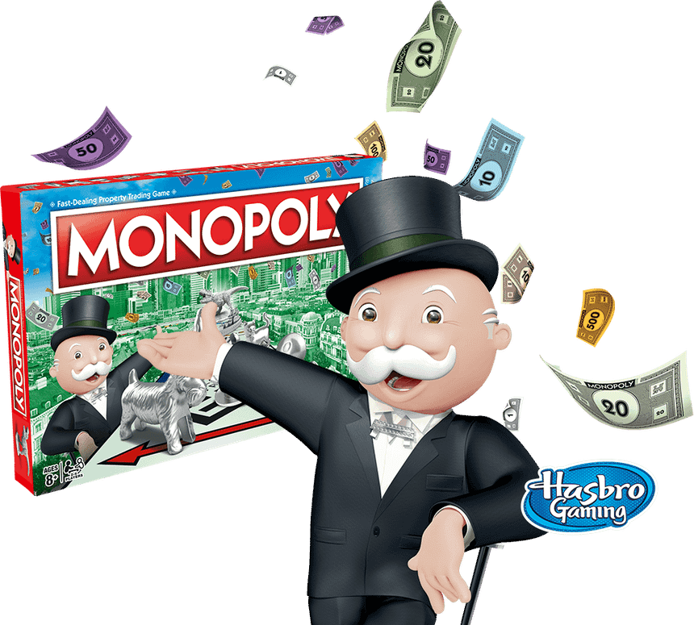
ABOUT MONOPOLY
Monopoly is a multiplayer economics-themed board game. In the game, players roll two dice to move around the game board, buying and trading properties and developing them with houses and hotels.
Players collect rent from their opponents and aim to drive them into bankruptcy. Money can also be gained or lost through Chance and Community Chest cards and tax squares. Players receive a salary every time they pass "Go" and can end up in jail, from which they cannot move until they have met one of three conditions.
Monopoly has become a part of international popular culture, having been licensed locally in more than 113 countries and printed in more than 46 languages. As of 2015, it was estimated that the game had sold 275 million copies worldwide.

Slide 4
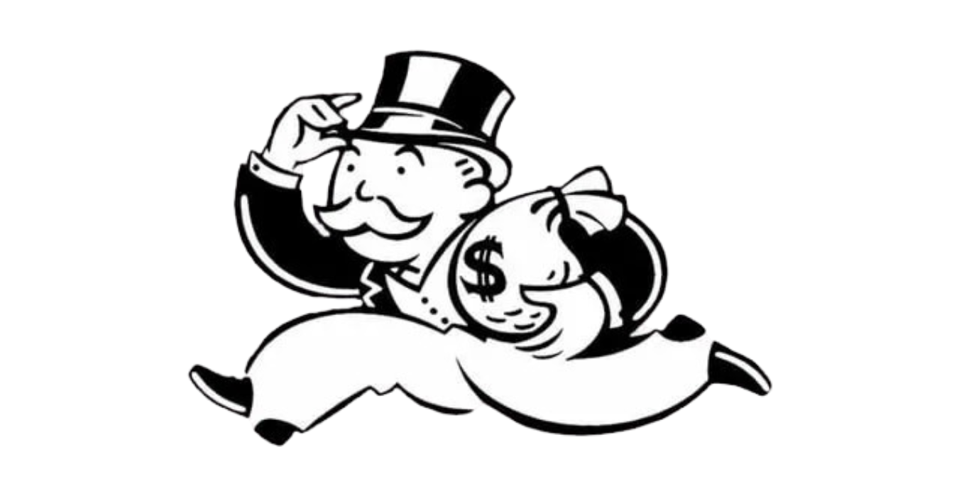
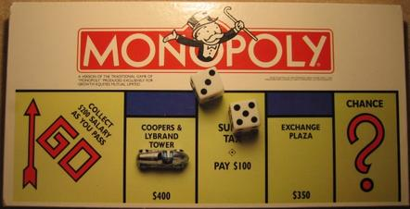
MR MONOPOLY
Mr. Monopoly is the mascot of the board game of Monopoly. He is depicted as a portly old man with a moustache who wears a morning suit with a bowtie and top hat. In large parts of the world he is known, additionally or exclusively, as the Monopoly Man, "Rich Uncle" Pennybags, Milburn Pennybags, or the Monopoly Guy. He also appears in the related games Rich Uncle, Advance to Boardwalk, Free Parking, Don't Go to Jail, Monopoly City, Monopoly Junior, and Monopoly Deal.
Between 1985 and 2008, the character appeared in the second "O" in the word Monopoly as part of the game's logo. More recently, he is depicted over the word "Monopoly", drawn in a 3-D style, extending his right hand. However, he no longer appears uniformly on every Monopoly game box.

Slide 5
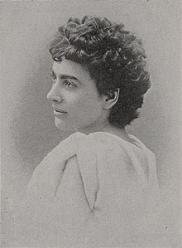
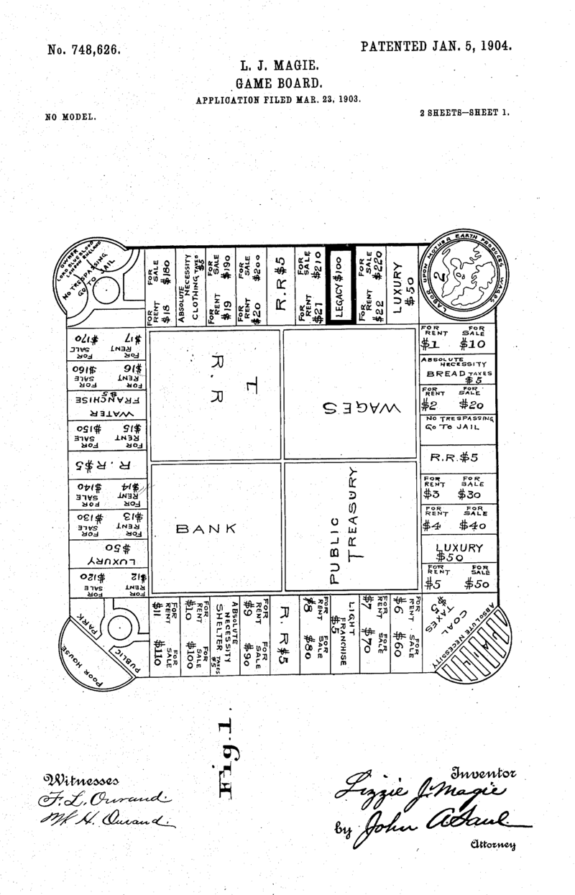
HISTORY OF MONOPOLY
The history of Monopoly can be traced back to 1903, when American anti-monopolist Lizzie Magie created a game called The Landlord's Game that she hoped would explain the single-tax theory of Henry George as laid out in his book Progress and Poverty. It was intended as an educational tool to illustrate the negative aspects of concentrating land in private monopolies. She took out a patent in 1904. Her game was self-published beginning in 1906.
Elizabeth J. Magie Phillips
The patnet in 1904

Slide 6
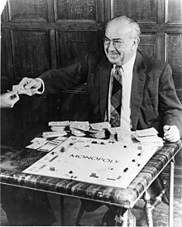


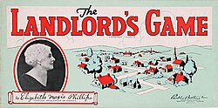
HISTORY OF MONOPOLY
Parker Brothers was an American toy and game manufacturer which in 1991 became a brand of Hasbro.
Magie created two sets of rules: an anti-monopolist set in which all were rewarded when wealth was created, and a monopolist set in which the goal was to create monopolies and crush opponents.
Several variant board games, based on her concept, were developed from 1906 through the 1930s; they involved both the process of buying land for its development, and the sale of any undeveloped property. Cardboard houses were added, and rents increased as they were added to a property. Magie patented the game again in 1923.
Current dealer of Monopoly Games
Darrow posing with a Monopoly board game set
After the meeting, the Charles Todds introduced Charles Darrow to The Landlord's Game, which they then played several times. The game was entirely new to Darrow, and he asked the Todds for a written set of the rules. After that night, Darrow went on to utilize it to distribute the game himself as Monopoly.
The Parker Brothers bought the game's copyrights from Darrow.When the company learned Darrow was not the sole inventor of the game, it bought the rights to Magie's patent for $500.
Cover of the game, displaying creator Elizabeth Magie

Slide 7
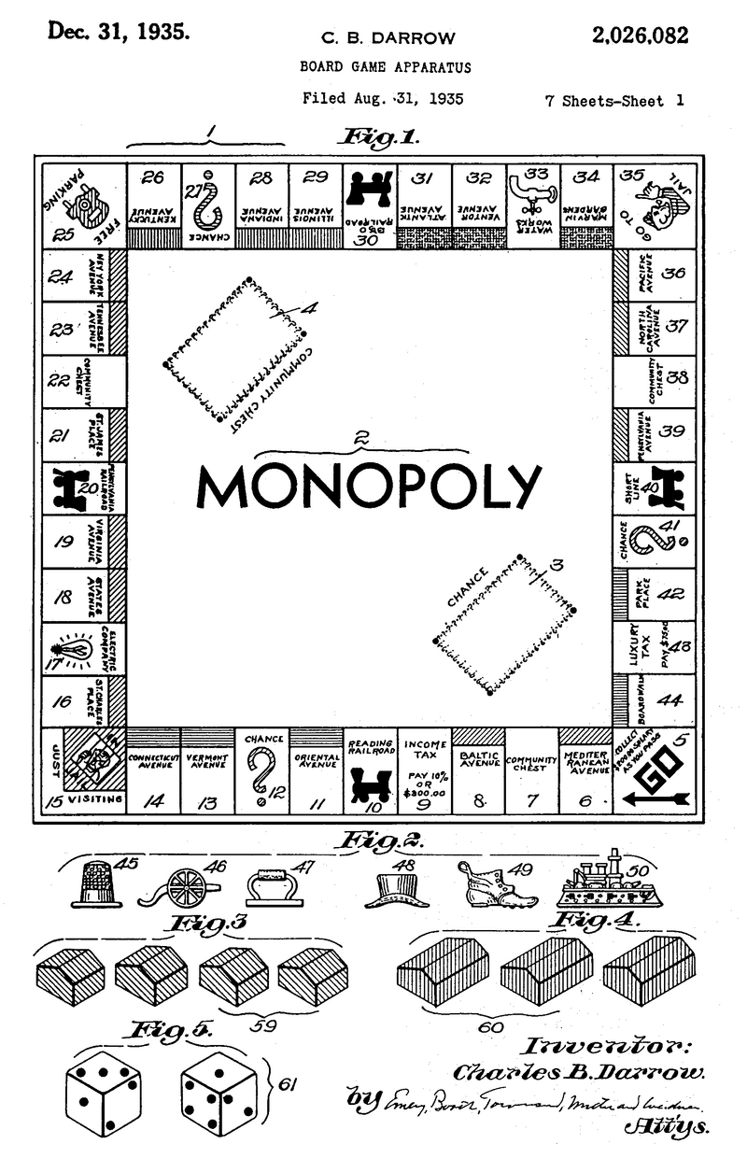
FIRST MONOPOLY GAME
The Monopoly game board consists of forty spaces containing twenty-eight properties—twenty-two streets (grouped into eight distinct color groups), four railroads, and two utilities—three Chance spaces, three Community Chest spaces, a Luxury Tax space, an Income Tax space, and the four corner squares: GO, (In) Jail/Just Visiting, Free Parking, and Go to Jail
US VERSIONS
There have since been some changes to the board. Not all of the Chance and Community Chest cards as shown in the 1935 patent were used in editions from 1936/1937 onwards.Graphics with the Mr. Monopoly character (then known as "Rich Uncle Pennybags") were added in that same time-frame.A graphic of a chest containing coins was added to the Community Chest spaces, as were the flat purchase prices of the properties. Traditionally, the Community Chest cards were yellow (although they were sometimes printed on blue stock) with no decoration or text on the back; the Chance cards were orange with no text or decoration on the back.
The original 1935 Monopoly board patent

Slide 8
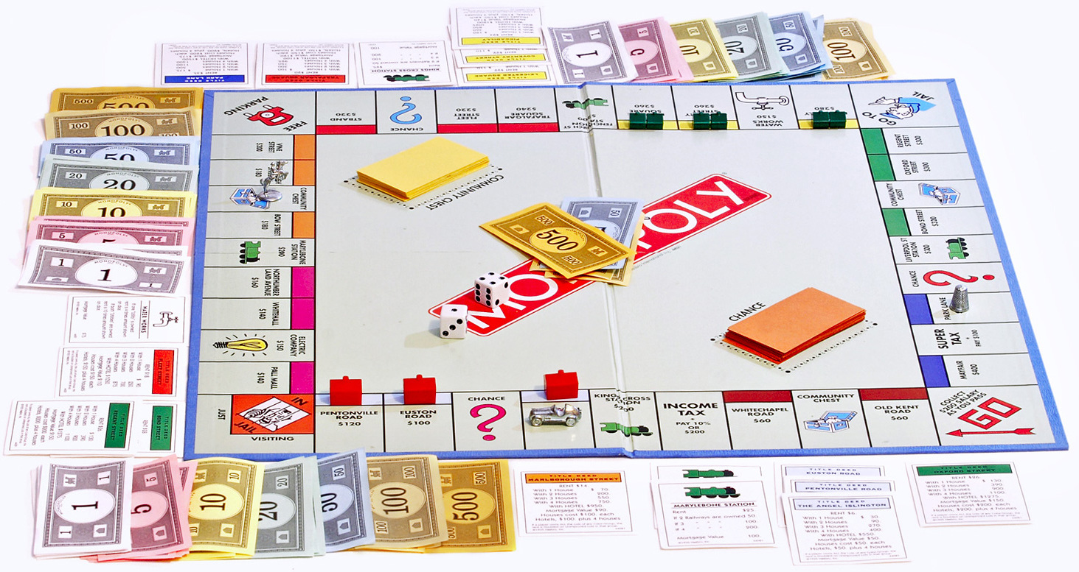
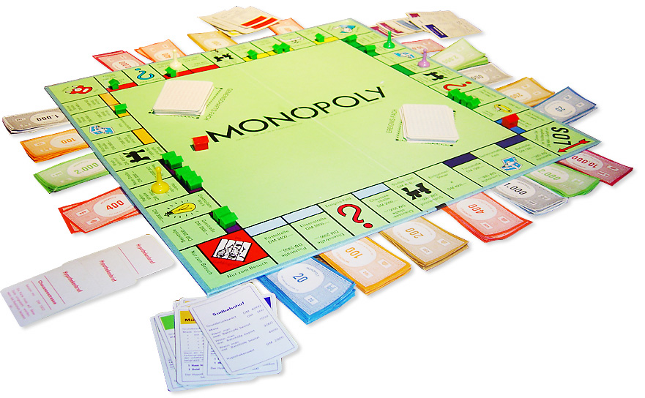
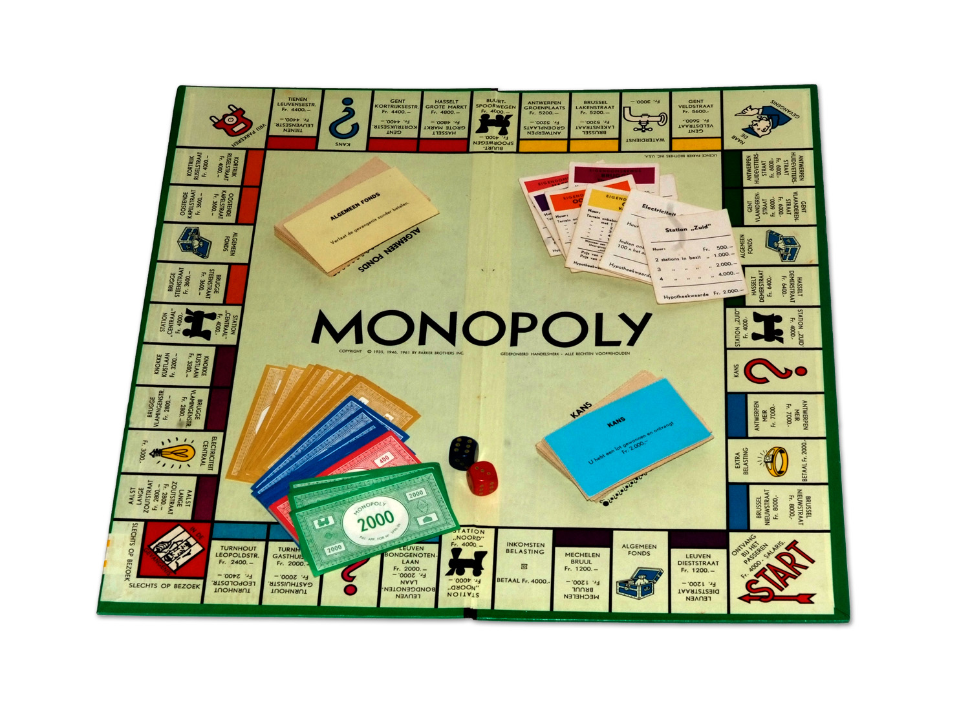
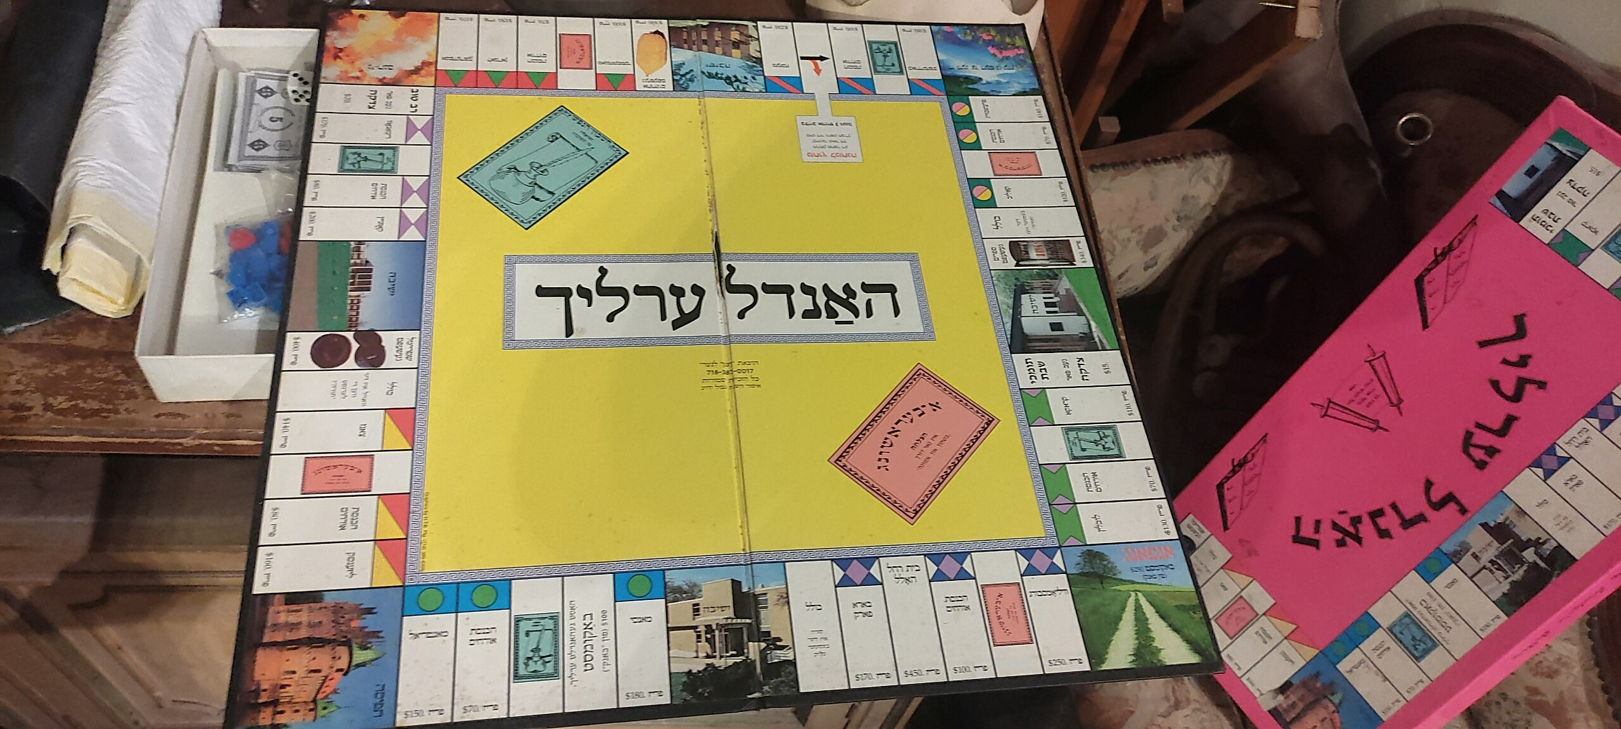
UK VERSIONS
In the 1930s, John Waddington Ltd., known as Waddingtons, was a printing company in Leeds that had branched out into packaging and the production of playing cards.Waddingtons had sent the card game Lexicon to Parker Brothers hoping to interest it in publishing the game in the United States. In a similar fashion, Parker Brothers sent over a copy of Monopoly to Waddingtons early in 1935 before the game had been put into production in the United States.
GERMAN
BELGIAN
AMERICAN JEWISH

Slide 9
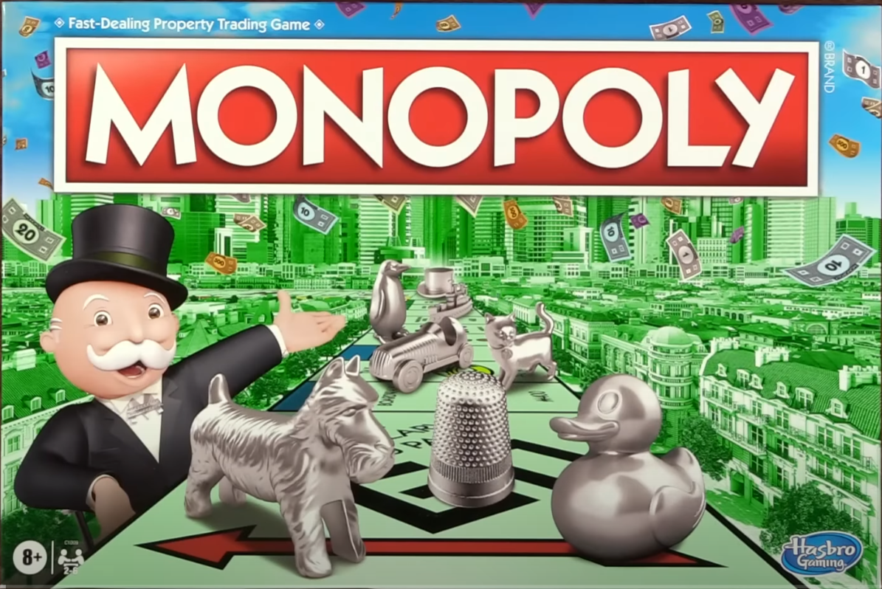
UNBOXING MONOPOLY

Slide 10
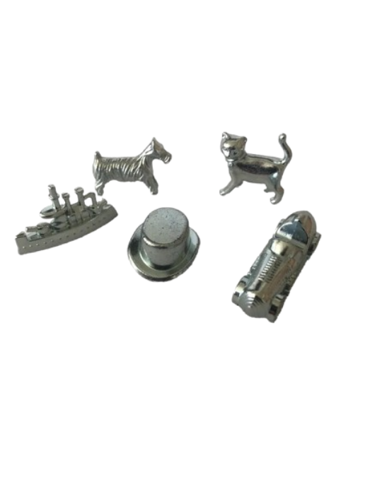
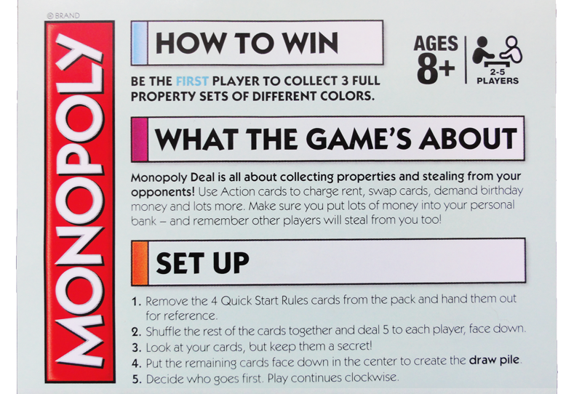
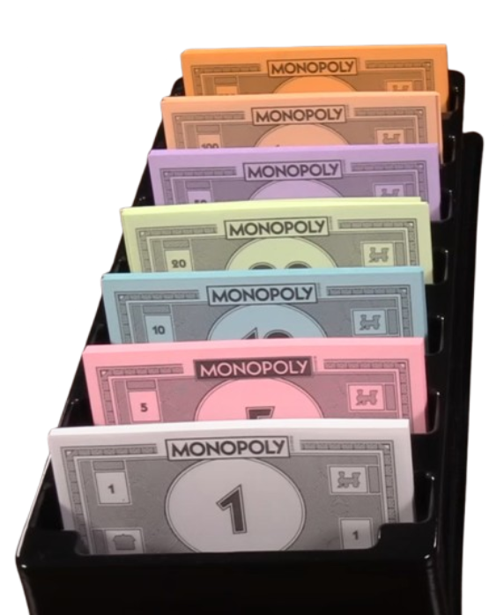
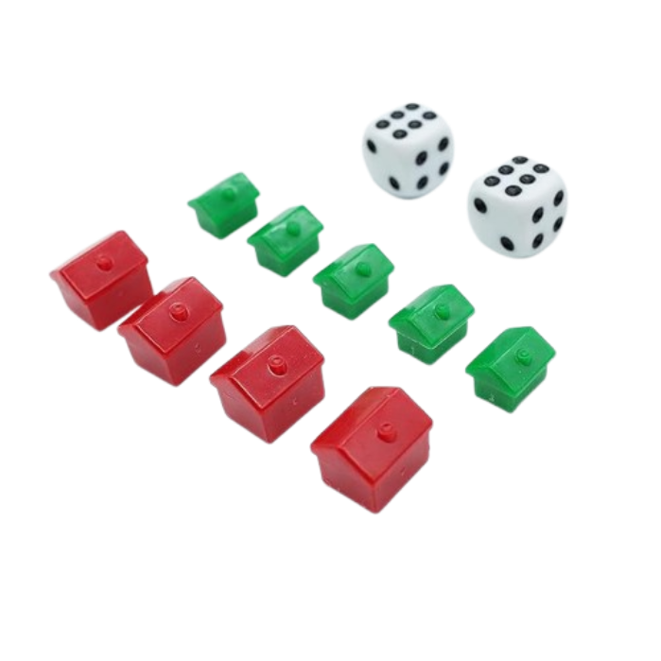
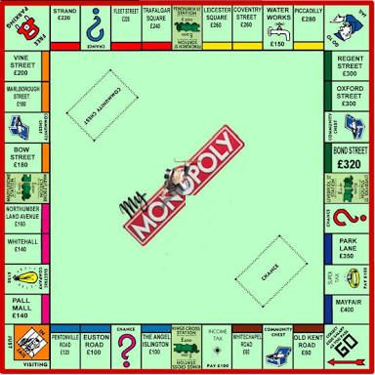
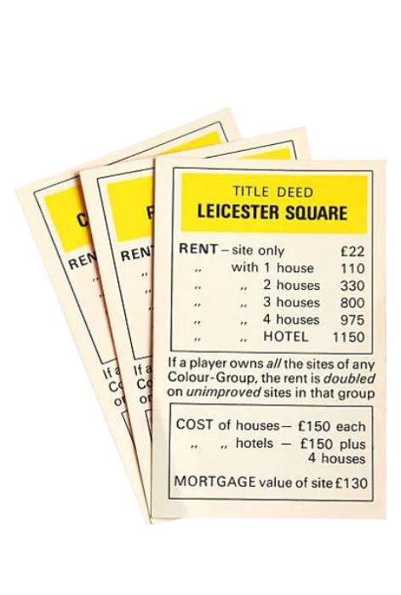
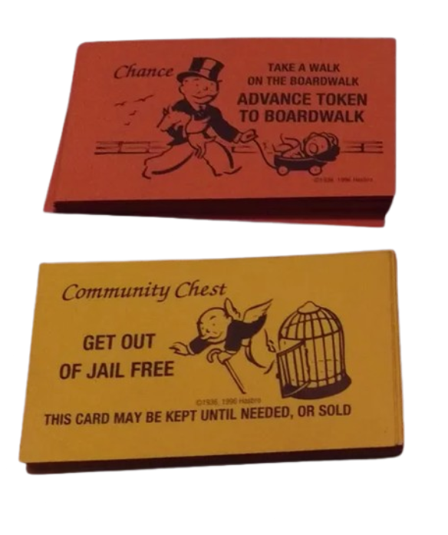
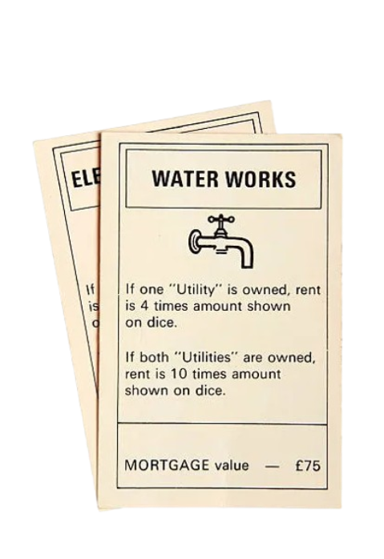
INSIDE THE BOX
Inside a Monopoly box, you'll find a game board, player tokens, property Title Deed cards, Chance and Community Chest cards, Monopoly money, houses, hotels, two dice, and a rulebook..
Rule Book
Set of different player tokens
Set of different currencies
Set of houses,hotels and two dice
Special Cards
Property Cards
Chest and chance Cards
Game Board

Slide 11
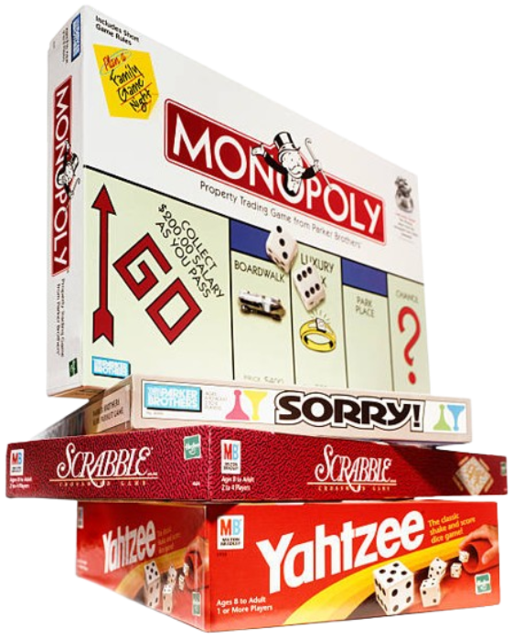
HOW TO PLAY MONOPOLY
Objective, Skills, Game Setup, Basic rules, Land Rules, Jail Rules, Build Rules, Trading Rules, Bank Rules, Winning Rule.

Slide 12
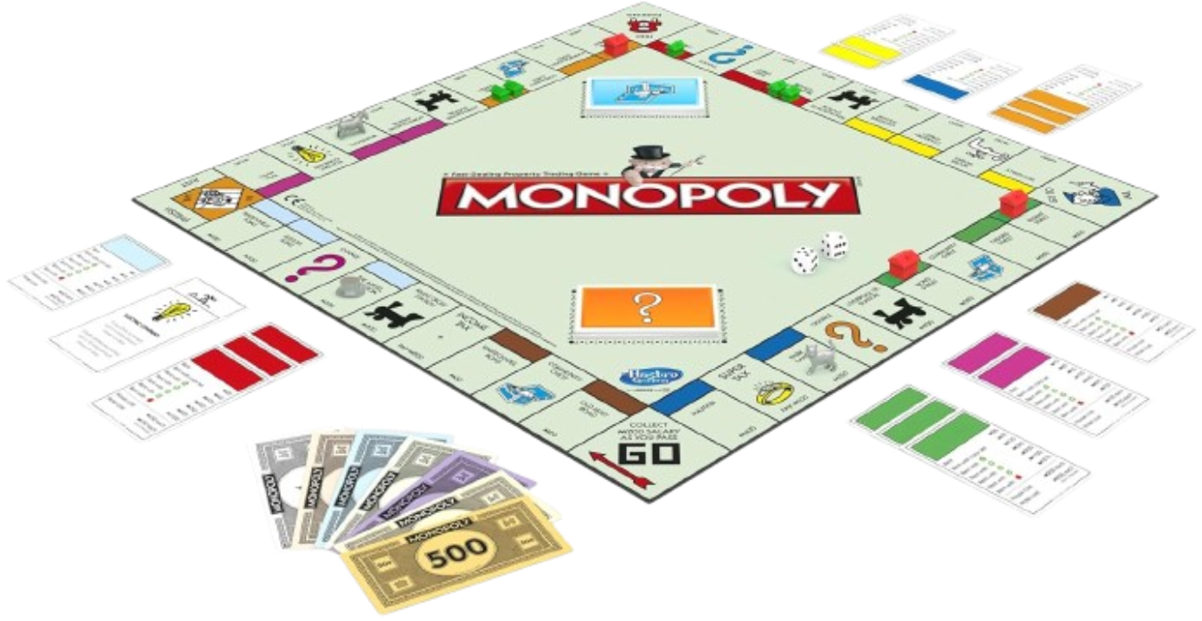
OBJECTIVE
SKILLS
The goal is to become the wealthiest player by buying, renting, and selling properties and eventually forcing other players into bankruptcy.
Negotiation
Resource Management
Financial Management
Strategy
GAME SETUP
Players: 2-8 players.
Money Given: About $1500
Board: Place the board in the center with all players around it.
Banker: Choose one player as the banker. The banker handles money, Title Deeds, houses, hotels, and auctions.
Money Distribution: Each player starts with $1,500 in various denominations.
Tokens: Each player chooses a token to represent them on the board.
Properties: Shuffle the Chance and Community Chest cards and place them face down in their respective spots.
Dice: Use two six-sided dice for movement.

Slide 13
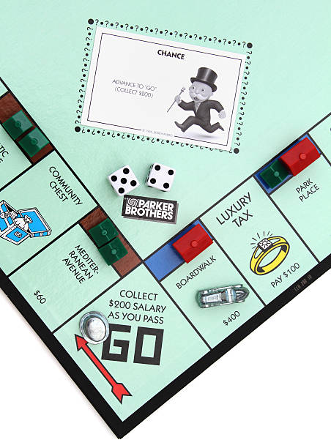
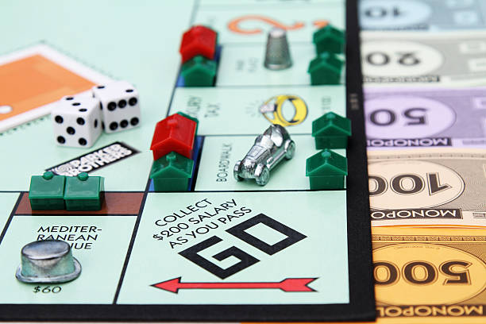
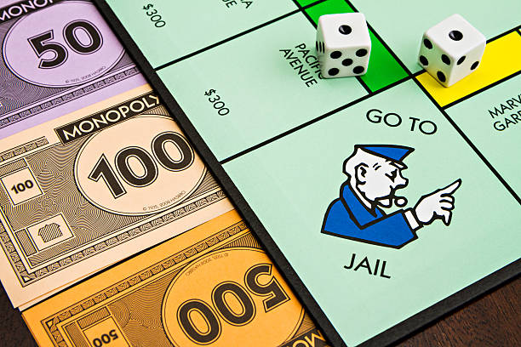
LAND RULES
BASIC RULES
Property: If you land on an unowned property, you can buy it from the bank at the listed price. If you don't want to buy, the banker auctions it to other players.
Rent: If you land on a property owned by another player, you must pay rent according to the property's Title Deed.
Chance/Community Chest: Draw a card from the respective deck and follow its instructions.
Income Tax/Luxury Tax: Pay the specified amount to the bank.
Starting the Game: Players roll the dice. The highest roller goes first, and turns proceed clockwise.
Movement: On each turn, roll the dice and move your token the number of spaces shown. If you land on or pass "Go," collect $200 from the bank.
Free Parking: Nothing happens; it's a rest spot.
JAIL RULES
If you land on the "Go to Jail" space, move your token directly to jail. You can leave by:
Rolling doubles on any of your next three turns.
Paying $50 before your next turn.
Using a "Get Out of Jail Free" card if you have one.
Own land by placing houses or hotels
BUILD RULES
Once you own all properties in a color group, you can start building houses and hotels to increase the rent.
Houses: Can be bought from the bank and must be built evenly across the properties in a group.
Hotels: Once you have four houses on each property in a group, you can buy hotels.
Multiples house can be replaced with hotels
You can visit jails or get out by paying

Slide 14
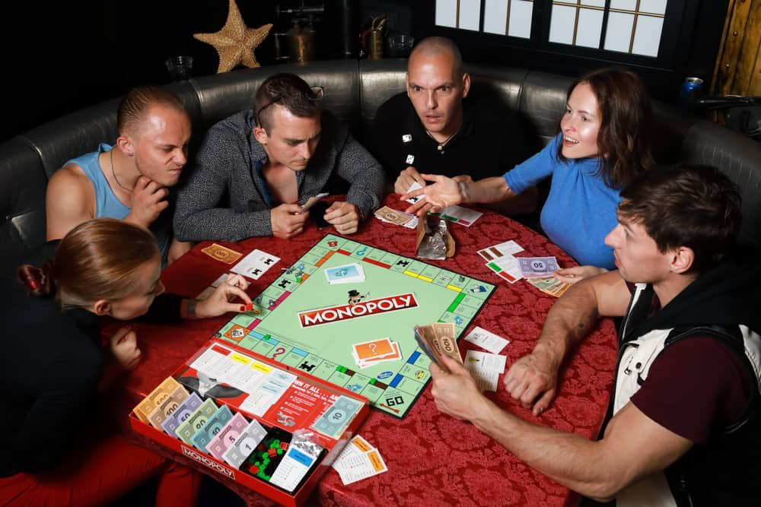
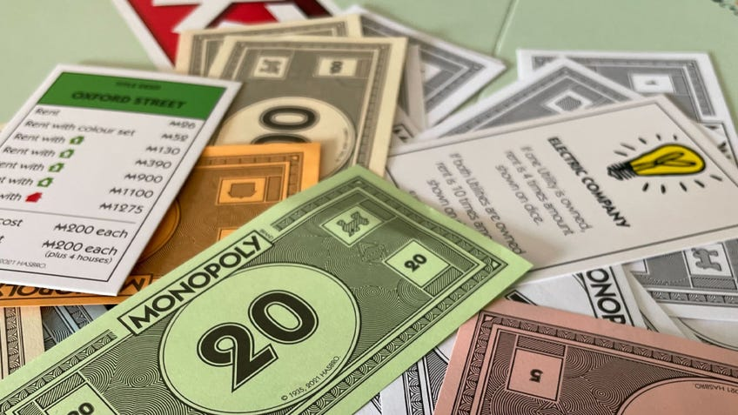
BANK RULES
Trading RULES
If a player owes more money than they can pay (either to the bank or another player), they are bankrupt and out of the game.
Sometimes the players can offer the bank for loan like policies for the sudden survival from his failure to the bankrupt.
Players can trade properties, money, or Get Out of Jail Free cards. Negotiations between the players can easily change the flow of the game.
Players can exchange the properties with or without money on the basis of personal agreements
WINNING RULE
The game ends when all players but one are bankrupt. The remaining player wins!
If the game is not able to finish as if the player keep on playing the sudden move is to stop the game and count the amount of money each player have and also the amount of the property they own in each places.

Slide 15
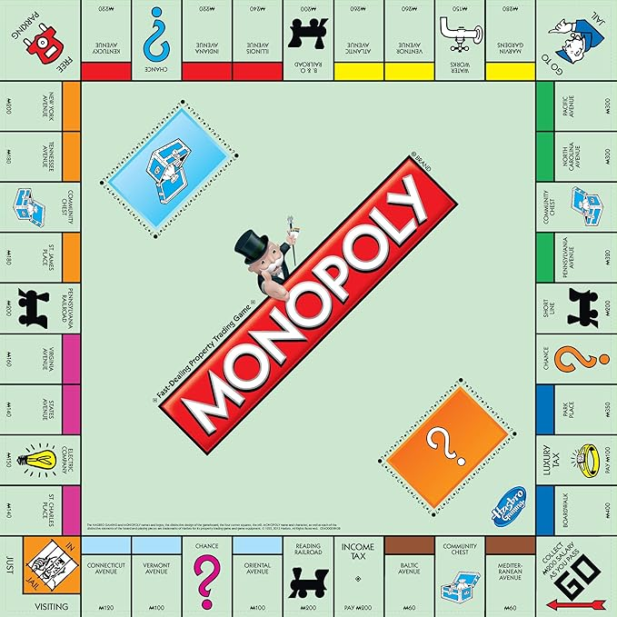
ABOUT THE BOARD
The Monopoly board consists of 40 spaces divided into:
1.GO: Collect $200 when passing or landing on it.
2.Properties: Color coded groups where players can buy, develop, and charge rent.
The 8 groups include: Brown, Light Blue, Pink, Orange, Red, Yellow, Green, Dark Blue.
3.Railroads: 4 railroads (Reading, Pennsylvania, B&O, Short Line) that increase rent when more are owned.
4.Utilities: Electric Company and Water Works. Rent depends on dice rolls.
5.Tax Spaces: Income Tax ($200 or 10%) and Luxury Tax ($100).
6.Chance & Community Chest**: Draw cards that provide rewards or penalties.
7. Jail: Players go to Jail via the "Go to Jail" space or card and must get out by rolling doubles, paying $50, or using a Get Out of Jail Free card.
8. Free Parking: No special actions.
9.Go to Jail: Move directly to Jail.

Slide 16
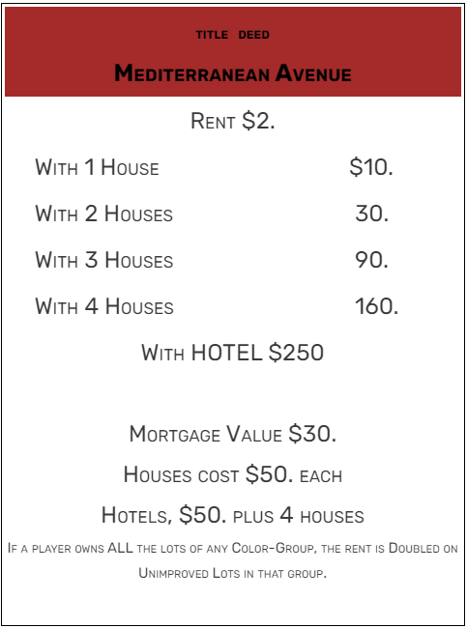
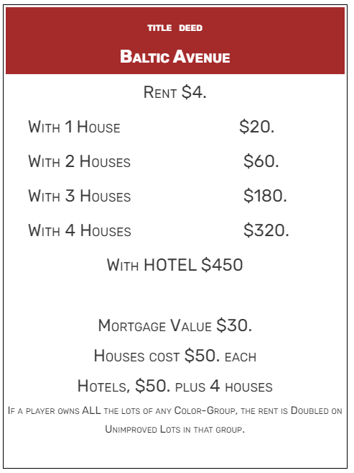
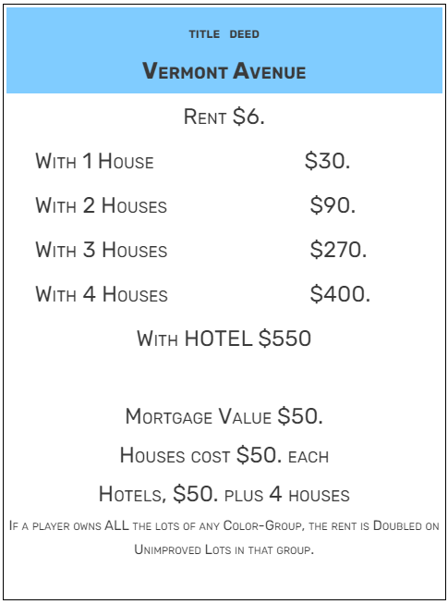
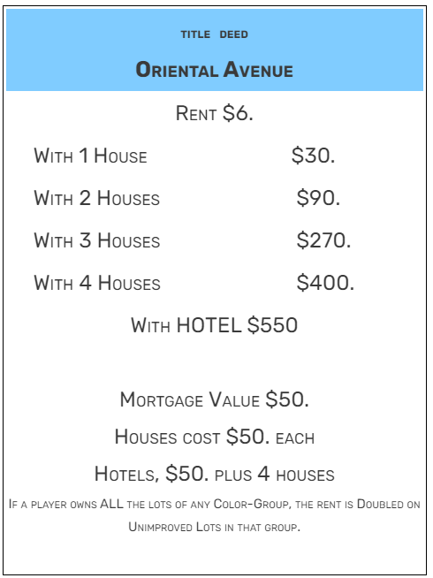
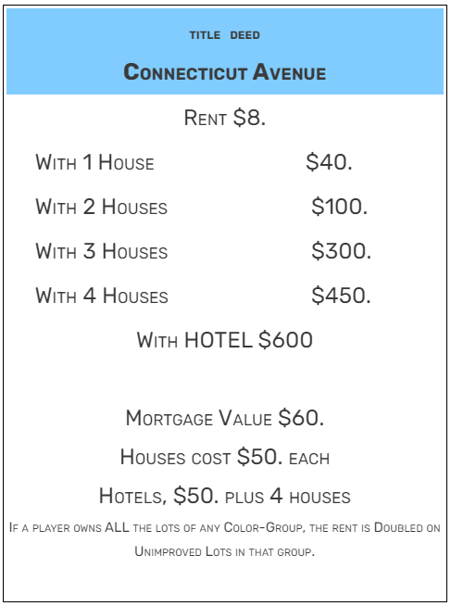
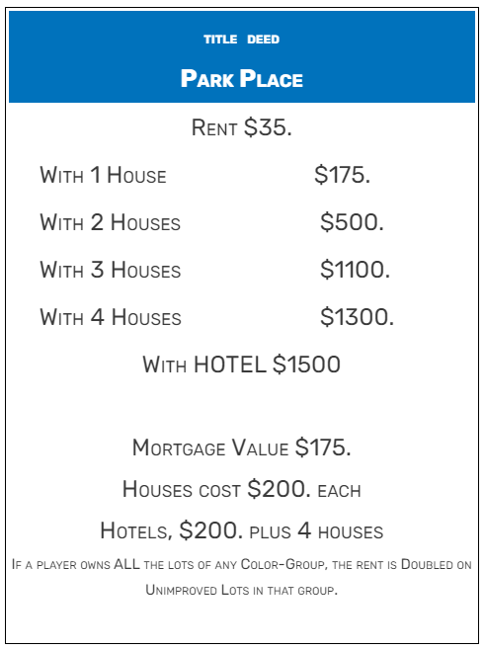
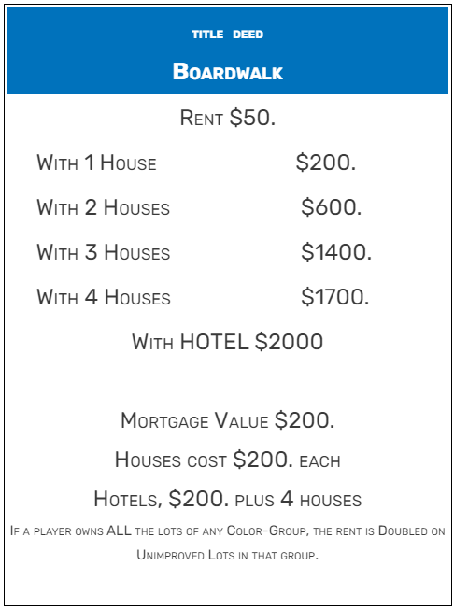
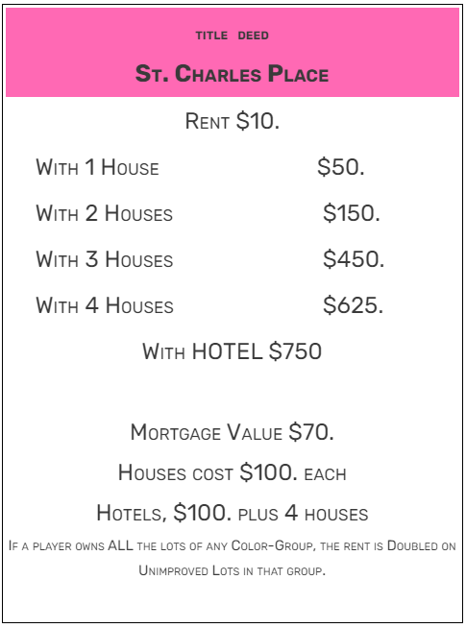
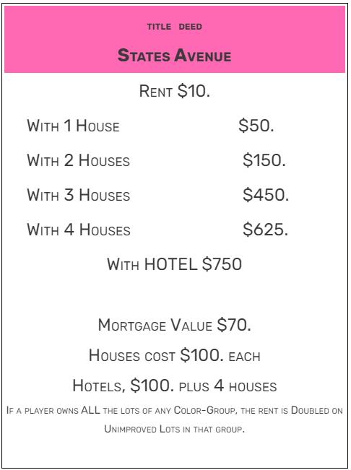
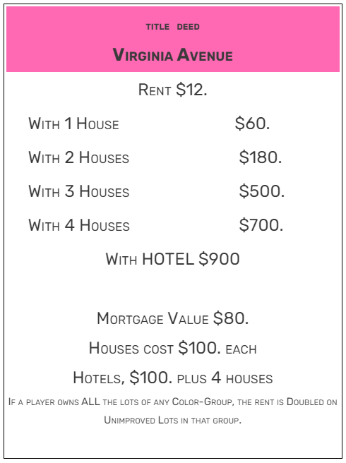
PROPERTY CARDs OF MONOPOLY
There are 8 sets of cards of different properties with different card color. The player can buy any of these properties from the banker by paying the price of the property. The player can setup houses, hotels and even charge rent when the opponent land on them.
BROWN CARDS
LIGHT BLUE CARDS
DARK BLUE CARDS
PINK CARDS

Slide 17
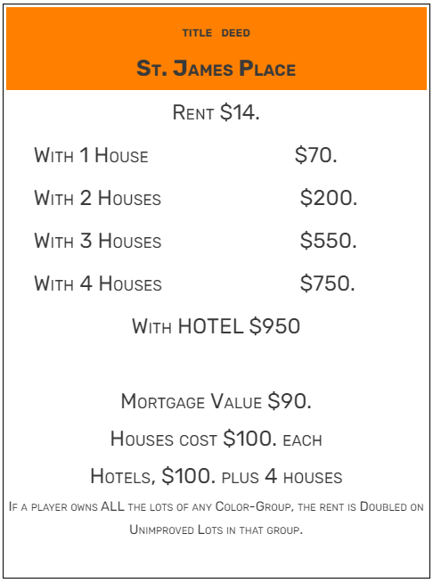
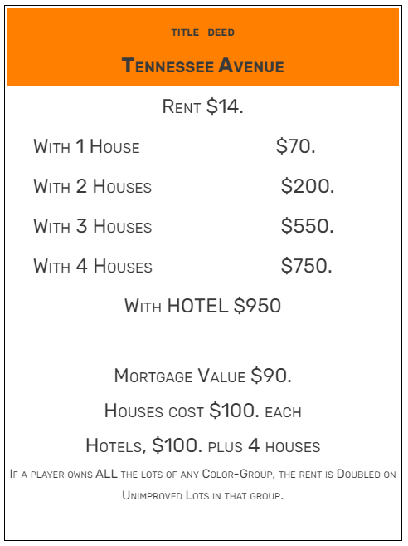
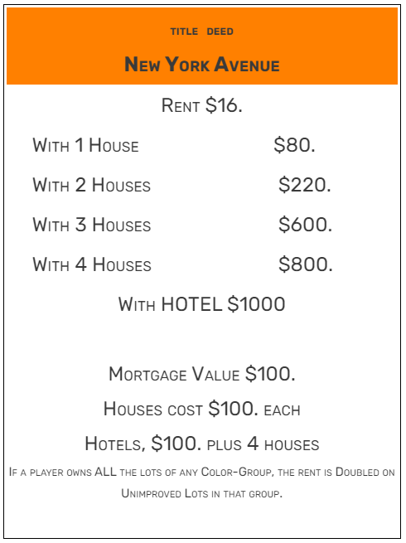
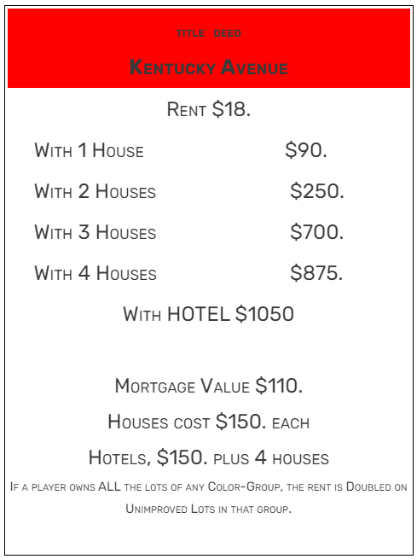
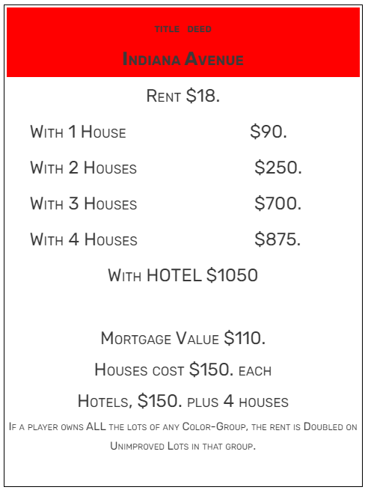
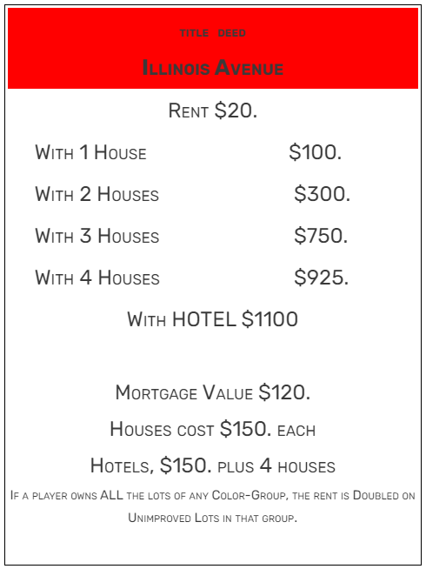
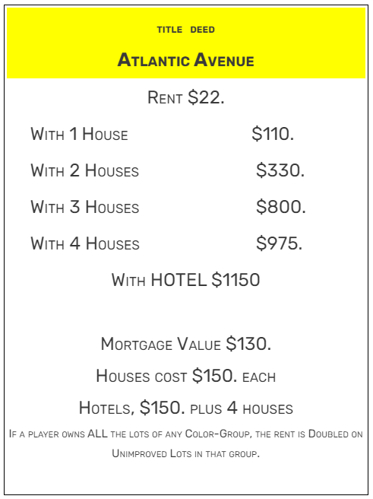

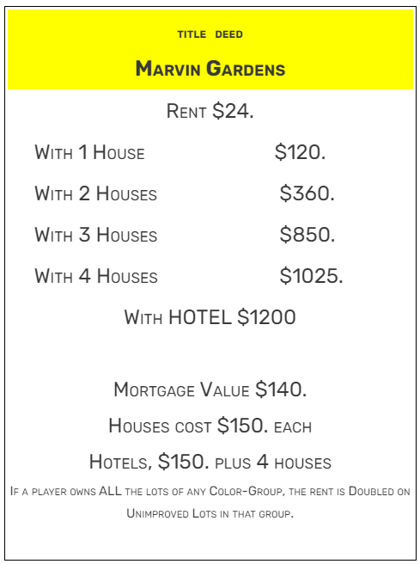
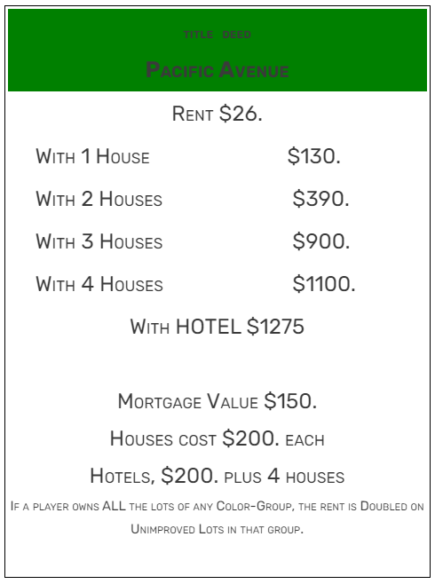
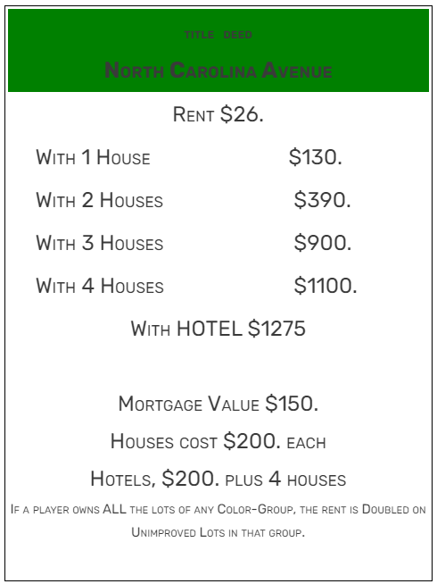
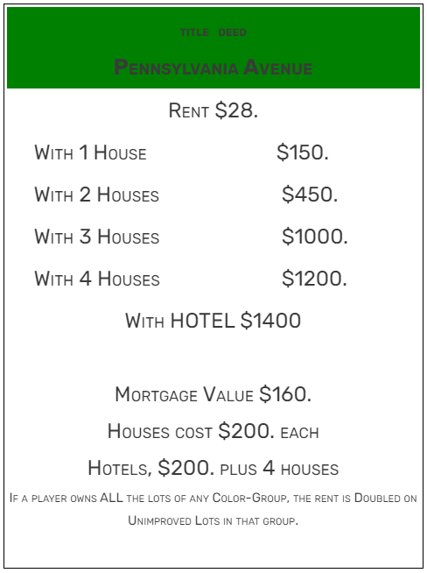
PROPERTY CARDs OF MONOPOLY
orange CARDS
RED CARDS
Yellow CARDS
GREEN CARDS

Slide 18






OTHER PROPERTY CARDs OF MONOPOLY
There are 2 sets of cards that are not like the other properties, where these properties stick more to the imaginary government like the basic services for running the city like the transportation, electric company and the water works. Like the other properties the player can buy any of these properties from the banker by paying the price of the property. The player can setup houses, hotels and even charge rent when the opponent land on them.
RAILWAY STATIONS
UTILITIES

Slide 19



SPECIAL CARDs OF MONOPOLY
There are 3 sets of special cards where the player can get them when the player lands on either the community chest or chance plot in the monopoly game board.
NEW CARD
The Bus Ticket is a new card in Monopoly: The Mega Edition.
It is used to move to any space in the side you are on. It can be taken by landing on the Bus Ticket space, landing on the Birthday Gift space and choosing the bus ticket or rolling the bus on the Speed Die.
If the player lands in any of these plots on the game the player can choose a card from the chance cards which can create a advantage or disadvantage move, like get free money from the banker or direct entry to the jail or pay fines.
Same like the chance cards, the community cards can make the same moves but sometimes the player can claim bigger rewards that the chance cards

Slide 20

CURRENCIES IN MONOPOLY
Monopoly money (symbol: ₩) is a type of play money used in the board game Monopoly. It is different from most currencies, including the American currency or British currency upon which it is based, in that it is smaller, one-sided, and does not have different imagery for each denomination.
20 $500 Bills (goldenrod orange)
20 $100 Bills (beige)
30 $50 Bills (blue)
50 $20 Bills (green)
40 $10 Bills (yellow)
40 $5 Bills (pink)
40 $1 Bills (white)

Slide 21




TOKENS USED IN MONOPOLY
In Monopoly, tokens are the pieces players use to move around the board. Each player chooses a unique token to represent them, and it moves based on dice rolls. The tokens help players track their position on the board and make it easy to tell who’s who. They also add a fun, personal touch to the game, as players often pick tokens they like or think are lucky. Ultimately, tokens help keep the game organized and enjoyable.
Other pieces used in the game are the houses, hotels and dice.
The houses are bought from the bank and placed on the plots. Where a combination of 4 houses can be converted to a single hotel which helps in the earning more tax when the opponent lands on them.
Tokens in the game changes according to the edition of the board game

Slide 22






EVOLUTION OF TOKENS IN MONOPOLY
Tokens are the playing pieces used in the Monopoly board game. They differ depending on the edition and the year of release of an edition. Standard editions, however different they are, usually use pewter tokens. In 1998, a new piece was voted on to be added to the existing 10 ( 11 in gold sets) The winner was a sack of money, which appeared in most standard editions until its retirement in 2007.
1936 Tokens (Deluxe Set)
Post-WWII Tokens
80th Anniversary Edition tokens
Electronic Banking Edition Tokens
Monopoly Cheater Edition

Slide 23




LIST OF MONOPOLY GAMES
There are hundreds of Monopoly game variations released worldwide, with themes based on different regions, popular culture, brands, and special editions. These variations can be grouped into several categories:
Monopoly Games (PC)
Fictional Monopoly Editions
Classic Editions: Standard Monopoly and Regional/City Editions
Themed Editions: Pop Culture, Video Games and Sports Edition
Special Editions: Anniversary Editions, Collector's Editions and Luxury Editions
Junior Editions: Simplified versions of Monopoly for younger players
Electronic Editions: Versions with electronic banking systems or digital apps instead of physical money
Card Games and Spin-offs: Monopoly Deal, Monopoly Empire and Monopoly Gamer.
Monopoly Gamer: Released for events or limited runs
Alternative editions of the classic Monopoly boardgame have appeared in media like in the Simpsons
There have been more than a dozen video game adaptations of Parker Brothers' highly successful board game Monopoly.
Several games that have come out throughout the years based on, and related to, the classic boardgame Monopoly.

Slide 24












Other MONOPOLY GAMES

Slide 25




MONOPOLY land
Monopoly Land is an official website to know everything about the game.

Slide 26
THANK YOU

